Slide 1
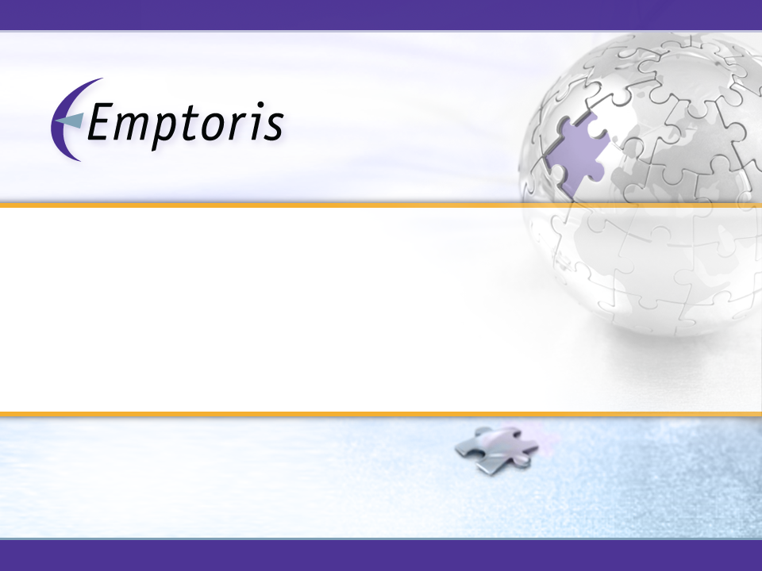
Contract Management
Implementation Workshop
October, 2013

Slide 2





Emptoris Delivers Comprehensive Contract Management
Visibility
Controls
Compliance
Gain visibility across your contract commitments
  Single Contract Repository
  Track the Amendments with Base Contracts
  Tackle Renewals Management Early
  Use Detailed Reporting to Support Consolidation
Control contract activities while leveraging your organization
  Adherence to Standards, Policies and Business Controls
  Automate Contract Risk Assessment
  Control over external Paper
Compliance to operational and regulatory standards
  Contracts drive ERP systems if required
  Full Relationship Management
  Demonstrable Controls
  Reduce Audit Costs
Example: search repository for past contracts with a company to uncover any issues that may make you want to avoid new deals

Slide 3
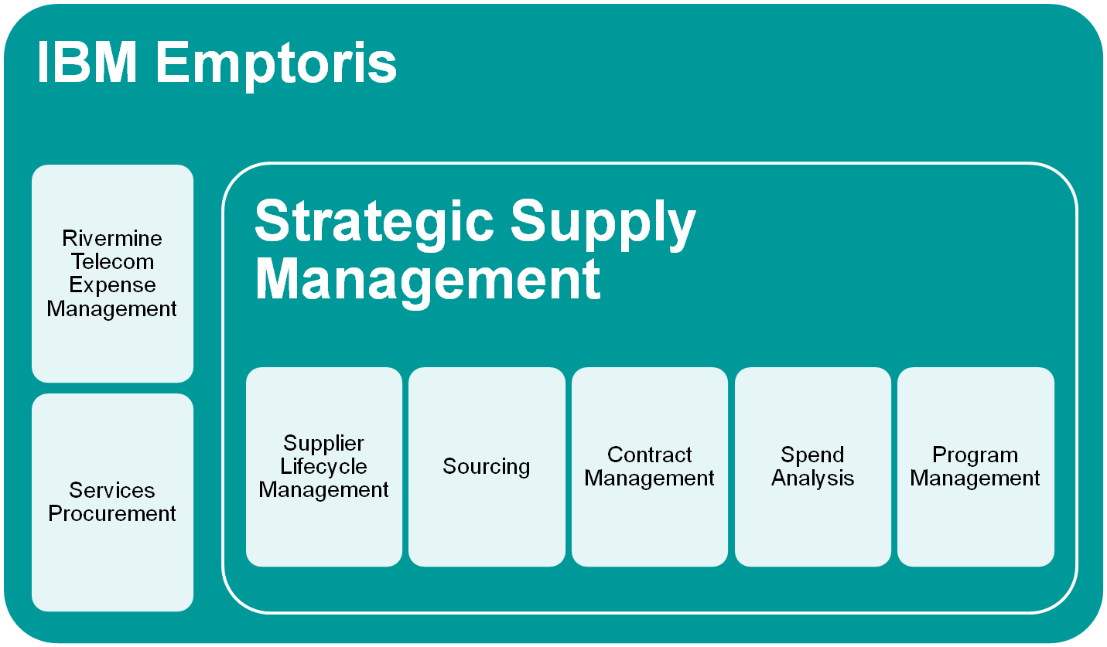
IBM Emptoris Product Offerings

Slide 4







Emptoris Strategic Supply Management
Application Suite
Supplier Management,
Risk and Compliance
Source to Contract
Enterprise and Category Spend Management
Supplier Lifecycle
Management
Sourcing
Contract
Management
Spend
Analysis
Telecom Expense
Management
Services
Procurement
Program
Management
22/04/13
Notes:
Product Suite breakdown
History
– Emptoris grew by acquisition before IBM
-- Products recently integrated in V10 version, post bluewash

Slide 5

Emptoris Solutions
IBM Emptoris Spend Analysis: Provides a complete, accurate and current view into corporate spend, enabling better decisions and delivering immediate cost savings.
IBM Emptoris Sourcing: Ensures that optimal allocations are made in all direct and indirect spend categories; from simple to complex; increases supplier collaboration and innovation; and reduces supply base risk.
IBM Emptoris Contract Management: Spans every stage of the contract management lifecycle, from contract creation and negotiation, to the management of obligations and enforcement of compliance, through contract amendment, renewal and ongoing analysis.
IBM Emptoris Rivermine Telecom Expense Management: Manages the entire communications life cycle and the analytics associated with these activities. E.g., may be paying bills for employees long departed.
IBM Emptoris Supplier Lifecycle Management: Enables complete transparency to all aspects of relationships with suppliers to address 100% of customer's supply-base.
IBM Emptoris Program Management: Provides real-time program visibility, actively managing a variety of key program tasks and capabilities to proactively monitor, measure and track savings and program objectives.
IBM Emptoris Services Procurement: Helps jump-start services procurement discipline by providing insight into the organization's services spend.
Also:
  Strategic Supply Management (SSM): Framework that encompasses most Emptoris products
  Emptoris Suite: Pre-acquisition name for SSM, but somewhat less integrated
  Virtual Supply Master (VSM): Part of SSM; central location for definitions of Suppliers

Slide 6
Emptoris solution benefits
Spend Analysis
  Typically the first Emptoris product used by a customer, most commonly in a Services engagement
  Ability to provide a complete, correct and detailed view of corporate spend. Allows executives to make informed decisions on where to deliver immediate cost savings enabling them to be more competitively positioned.
  Categorises spend from any number of different feeds (ERP's, AP systems)
  Savings of up to 2% by Spend Analysis alone
Supplier Management
  Ability to access information about all suppliers globally in the same place.
  Defining and managing risk, which is inherent to business but understanding where risk and exposure exists is key to understanding the business.
  Ability to assess supplier performance and taking remedial action
e-Sourcing
  Emptoris sets the standard for driving bottom- and top-line savings.
  Ability to drive RFx and Reverse Auctions
  Savings up to 14% achieved.
Contract Management
  Gain global contract visibility. Instantly provides visibility and access to intelligence held within the contract portfolio. Apple and Conde Nast are among customers.
  One healthcare company uses Contract Management to manage 600K contracts
  Access to all of contracts from procurement, legal and operations via a centralised repository.
  Enriches data and improves accuracy enabling:
    Elimination of savings leakage
    Identification of new savings opportunities
    Reduction of maverick spend through increased compliance
  Can be applied to sales contracts too

Slide 7
A Short (Recent) History of Emptoris Suite / SSM
Version 9.0 (GA December, 2011)
Version 9.5 (GA July, 2012)
  First release after Emptoris acquisition by IBM in February, 2012 (numerous earlier acquisitions by Emptoris)
  Introduction of SSM and VSM to centralize management of Suppliers, Users, Organization, Categories
  Next generation of Supplier Lifecycle Management
  Support for IBM technology (WebSphere, DB2, Cognos, InfoSphere)
Version 10.0 (GA December, 2012)
  Single sign-on
  Further enhancements to SSM and VSM (more functionality centralized from individual applications)
  Additional integration of functions between applications
Version 10.0.1 (GA May, 2013)
  Added new functionality to migrate from pre-V10 systems to V10.x
Version “next” (GA “soon”)
  Many relatively small new functions and improvements
… plus significant other enhancements in most applications in most releases

Slide 8










Technologies Provided or Required (V10.0)
(IBM/Emptoris Software and Pre-Requisites)
Legend
Delta
IBM Emptoris Strategic Supply Management
Same
SLM
Sourcing
Contracts
Spend
PgM
8.5
10.2
Provided
8.7
VSM
VSM
VSM
VSM
VSM
5.5.15
9.7 FP6
Required
11.2.0.3.3
5.7
2008 R2
Notes:
All Products Require:
WebSphere Application Server, V8.5 Standard Edition 64-bit (limited use license included with purchase)
Contract Management Reporting also requires:
IBM Cognos Business Intelligence Platform 10.1.1 (limited use license included with purchase).
IBM InfoSphere DataStage 8.7 (limited use license included with purchase).

Slide 9

Technologies Provided or Required (V10.0.1)
(IBM/Emptoris Software and Pre-Requisites)
Legend
Delta
IBM Emptoris Strategic Supply Management
Same
SLM
Sourcing
Contracts
Spend
PgM
8.5
10.2
Provided
8.7
VSM
VSM
VSM
VSM
VSM
5.5.15
9.7 FP6
Required
11.2.0.3.3
5.7 or 6.0
2008 R2
2012 Standard
Notes:
All Products Require:
WebSphere Application Server, V8.5 Standard Edition 64-bit (limited use license included with purchase)
Contract Management Reporting also requires:
IBM Cognos Business Intelligence Platform 10.1.1 (limited use license included with purchase).
IBM InfoSphere DataStage 8.7 (limited use license included with purchase).

Slide 10




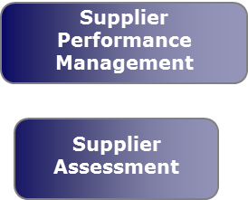
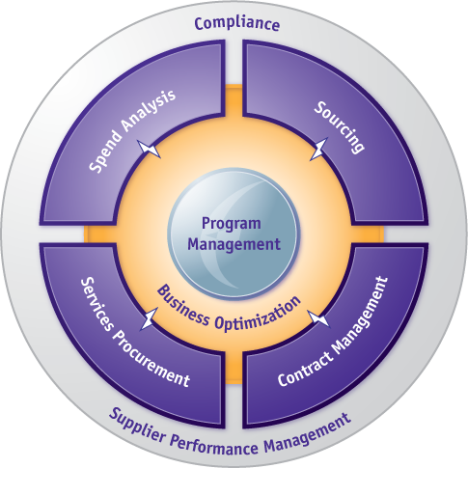
Supply & Contract Management
- Enabling Technologies
Business
Process
Strategic
Sourcing
Contract
Management
Purchase
to Pay
Supplier
Management
Sub
Process
Supply Strategy
Negotiations
Contract
Creation
Contract
Negotiation
Contract
Award
Requisition
To Pay
Contract
Compliance
Performance
Management
Supplier Development
Program Management
Enabling
Technologies
Sourcing
Contract Management
ERP
Spend to
Contract
visibility
e-proc.
Serv. Proc.
Spend
Analysis
ERP-Contacts
Integration
Procure to Pay
Control Monitoring
Legend
Other solutions
Emptoris suite

Slide 11
Emptoris Solution
- Supporting Enterprise Contract Lifecycle
Process
Contract
Preparation
Pre Contract
Creation
Contract
Creation
Contract
Management
Comply
Sub
Process
Policy
Procedures
Processes
Procurement Tender
Sales Proposal
Draft, Collaborate, Negotiate, Signature, Activation, Store
Monitor, Transact, Performance, Exceptions, Audit
Find, Amend, Renew Terminate
Enabling
Technologies
Terms
Clauses
Templates
Org. Model
Workflow
Notifications
eRFX
Webservices
Central Repository
Authored Contracts
Filed Contracts
External Party Paper
Relationships
Presentation& Execute
Review/Approve/Remind
MS Word Integration
Wizard
Searching
Consolidate
Amendments
Milestone Events
Renewals
Terminations
Deliverables
Contract Process KPI
Audit Trails
SOX Reporting
ERP Integration
Spend to Contract
Monitoring
Performance to
Contract Monitoring

Slide 12
Contract Lifecycle Management Cycle
Initiate Agreement
Approval Procurement and BU on Plan
Evaluate
Draft Legal Contract from Templates
Monthly Reporting
EVALUATE
PLAN
Negotiation Plan
Performance / CRM
EXECUTE
Negotiation, Approval and Signing
Rebate Settlements
REALIZE
Contract Monitoring
Store Contract
Rebate Overview Update
Spend
Update

Slide 13
The Unofficial Abridged Emptoris Glossary
ECM – Emptoris Contract Management
Terms – Contract Metadata
Language – The legal content of the contract
Presentation – Process step where contract is shared with the supplier
Execution – When the contract is fully agreed with both parties, contract is executed.
Owning Organization – The business unit responsible for maintaining the contract
Internal Party – The legal entity on the contract

Slide 14





Types of Contract
Type of Contract | Language Source | Collaborate and Negotiate in ECM | Term Integration with Language
Filed Contract | “Attached File” Pre-signed contract document, typically a .pdf
Received Contract | “Word Document” Internal language template, or supplier paper |  | Only by Manual Insertion
Authored Contract | “Contract Template” Legal Language pre-loaded into the contract template

Slide 15
Contract Management Process
Initiate Contract
A
Select
Unique Name
Contract Type/Template
Company/Contact
Present to
External Company
Modify Contract
Edit Terms/Clause Language
Add Alternate Adhoc Clause
Omit / Delete Clause
Add Attachments, Events and Tracking Terms
Negotiate
Accept, Reject, Withdraw
Cancel
Request Review
Execute
Approvals
Clause
Contract
Repository
A

Slide 16

Negotiation/Presentation Options
Presentation Options
Online (external party is notified, and logs in and can edit contract)
Offline (contract owner checks out contract and sends it to external party, who edits and sends it back for check in)
Email (external party gets an email with attached contract; they edit it and return it for check in)
Negotiability
Accept/Decline (external party can either accept the contract as offered, or reject it)
Negotiable (external party can negotiate contract details)
Initiate Contract
A
Select
Unique Name
Contract Type/Template
Company/Contact
Present to
External Company
Modify Contract
Edit Terms/Clause Language
Add Alternate Adhoc Clause
Omit / Delete Clause
Add Attachments, Events and Tracking Terms
Negotiate
Accept, Reject, Withdraw
Cancel
Request Review
Execute
Approvals
Clause
Contract
Repository
A

Slide 17
What is a “Contract Template”?
Not just the legal document template
An ECM Contract Template also controls:
  The type of contract that can be created
  The security of who can view contracts
  Approval Workflows
  Contract Metadata (Terms)
  Contract Attachments
  The Contract Lines structure

Slide 18
Contract Building Blocks
Clause Library
Contract Template
Contract Creation
1. ----------------------
-------------------------
-------------------------
-------------------------
-------------------------
Clause 1
Clause 2
Clause 3
(e.g.,
Payment Appendix
Fee Schedule)
1. ------------------------
---------------------------
2. ------------------------
--------------------------
3. ------------------------
--------------------------
2. ----------------------
-------------------------
-------------------------
-------------------------
-------------------------
Virtual Document
------------------------------------------------------------------------------------
3. ----------------------
-------------------------
-------------------------
-------------------------
-------------------------
4. ----------------------
-------------------------
-------------------------
-------------------------
-------------------------
Terms
Names / Dates
Amounts / Quantities
Time Periods (Days, Months, etc.)
Payment methods
etc.
Track changes
Events & Notifications
Attachments
Approval Chains
Term Sheet (Summary)
Notes
Activity History
On-line Search
Reporting
etc.
Alternate
Language
Legal
Format

Slide 19

Implementation: Discussion Points
What is the existing process for contract management?
Who:
  Drafts the contracts?
  Approves the contracts?
  Negotiates the language with the Supplier?
  Signs the contracts?
  "Owns" the live contracts?
  Amends contracts?
What types of contract do you have paper contracts vs. lines only for?
Do you have existing review and approval definitions?
Who owns the contract templates?
Who should have access to the existing and new contracts?
  Regional view restrictions?
  Role based restrictions?
  Category based restrictions?
  Organization based restrictions?

Slide 20

Implementation: Workshop Planning
Contract Repository Design
Contract Components Design
Contract Security Model
Contract Authoring Design
Contract Interview Wizard Design

Slide 21
Contract Repository Design
What contracts will be loaded into the repository?
Copy lines contracts into the system?
What metadata information is available for the load?
Data extraction, conversion and load planning
Cutover process

Slide 22

Contract Components
Types of Contract
  NDA’s, Frameworks, Generic Agreements
Terms: (Metadata) fields for notification, tracking, reporting, and approvals.
  Language terms – used in contract language
  Notification terms – Warranty dates, Review dates.
  Tracking terms – for searching
  Reporting – what do you want to report on?
  Approvals – terms to route approvals
Clause Types – for classifying clauses
Lines Structures – what product/price data will be included?

Slide 23
Reporting
Contract Management license provides access to the following modules from IBM Cognos Business Intelligence Reporting:
  IBM Cognos Business Intelligence Reporting
  IBM Cognos Supporting Languages Documentation
  IBM Cognos Business Intelligence Samples
These modules provide access to IBM Cognos Connections, Report Studio, and Business Insight Advanced.
IBM Cognos Business Intelligence Platform and IBM InfoSphere DataStage are supported on the Linux (RHEL).

Slide 24
Using Cognos Reporting
Reporting Models and Standard Reports will help you create the reports a client needs.
There are ~24 standard out-of-the-box reports.
There are 29 models to facilitate custom reports creation.
Reporting models are similar to the universe of data in previous reporting systems.
The Reporting models delivered with ECM range from activities and tasks, to objects and relationships.
Packages are subsets of a model, containing items that you can insert in a report.
Packages ensure that you add the correct data items to a report.
Contract data is grouped into folders and elements and is collectively referred to as the Reporting Framework Model.

Slide 25
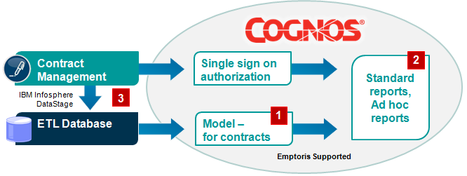

Using Cognos Reporting, cont.
Reporting models do not maintain the security of certain objects and therefore, careful consideration should be exercised when granting access to these models.
References: Contract Management Key Business Reports Guide, Contract Management Reporting Model Guide

Slide 26
Emptoris V10.0.1 and Migration
Prior to V10, Emptoris products have stored user/common data in their own application Databases in their own formats.
As of V10, that data is stored in VSM in a different format.
V10.0 did not include a migration capability, so users on V9.x and earlier could not move to V10 (while keeping their data).
V10.0.1 added migration capability that extracts and transforms application data to VSM format. Two scenarios:
  Migration 1: V7.x onwards to v10.0.1
    Supporting legacy applications / Suite (Sourcing, Contract Management and Spend Analysis) to migrate to 10.0.1
    Needs Services, AppMgmt and Extraction Tool to do this migration
  Migration 2: V10 to v10.0.1
    Out of box; will happen automatically when SSM V10.0.1 is started
    A customer on V10 uses VSM and therefore there is no need to do any common data migration as for Migration 1.

Slide 27
Migration Assumptions
Migration is performed on same type of Database
Primary database focus of Migration will be Oracle 11g/11.2.0. (Most of the existing customers are on Oracle DB.)
Core Migration considers Sourcing, Contract Management, and Spend as the primary targets.
Migration focuses on loading the data in right format, and not on data clean-up. Data cleansing can be done separately and should be kept independent of migration.
Customers need Services help to do this Migration
SLM Classic to SLM-NG is a separate process, and is not part of this standard migration
Legacy suite migration with SLM is a separate project, and is out of scope as core deliverable.
Extraction Tool is built and shipped independently of core product

Slide 28
Migration Nuances for ECM
Organization Code gets modified to “Org Name” + “Org Number”
User Group name gets modified with product label prefix in case of duplicates
New roles are assigned to users in VSM based on permissions in ECM
Users with self as managers in ECM will not have the manager field populated in VSM
Users need to change their passwords when they log in for the first time after migration
Users with expired passwords will be moved to VSM in deactivated state
Security question and answer from ECM not valid after migration
Email for users/contacts is mandatory. If not found, system populates email as missing_data@missingdata.com
External organizations with no users will be migrated as stand-alone ECM suppliers, even if the integration flag is checked on such records.
Effective end date functionality not available any more for all the objects moved to VSM.
For addresses, Street 2 will be modified as concatenation of Street 2, Street 3 and Street 4 fields.

